Slide 1
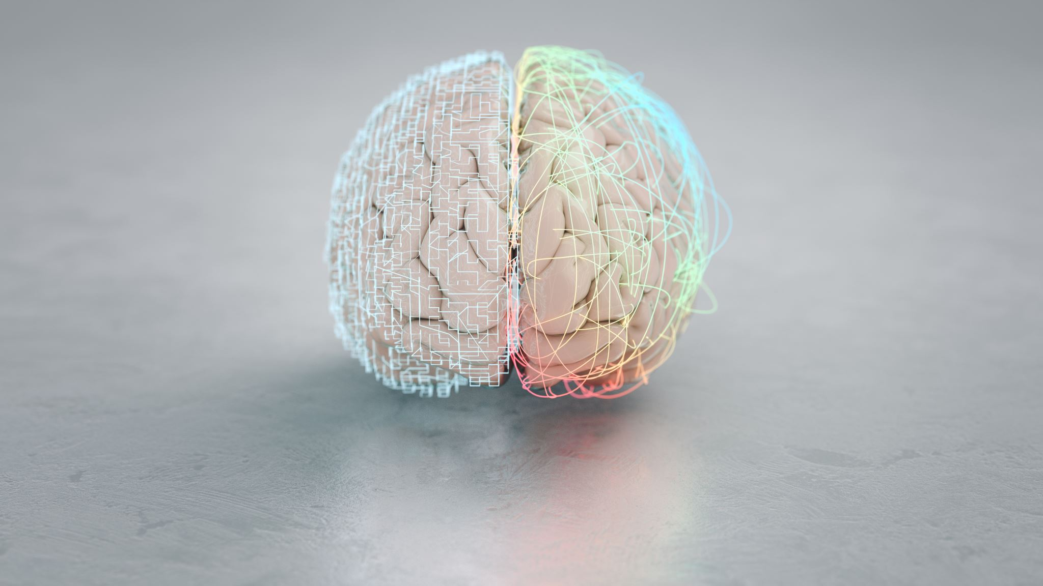
Brain Tumor Detection by Group-1
Mani Sai Deeraj Marru 11667818
INFO 5505 | Dr. Wael Korani

Slide 2
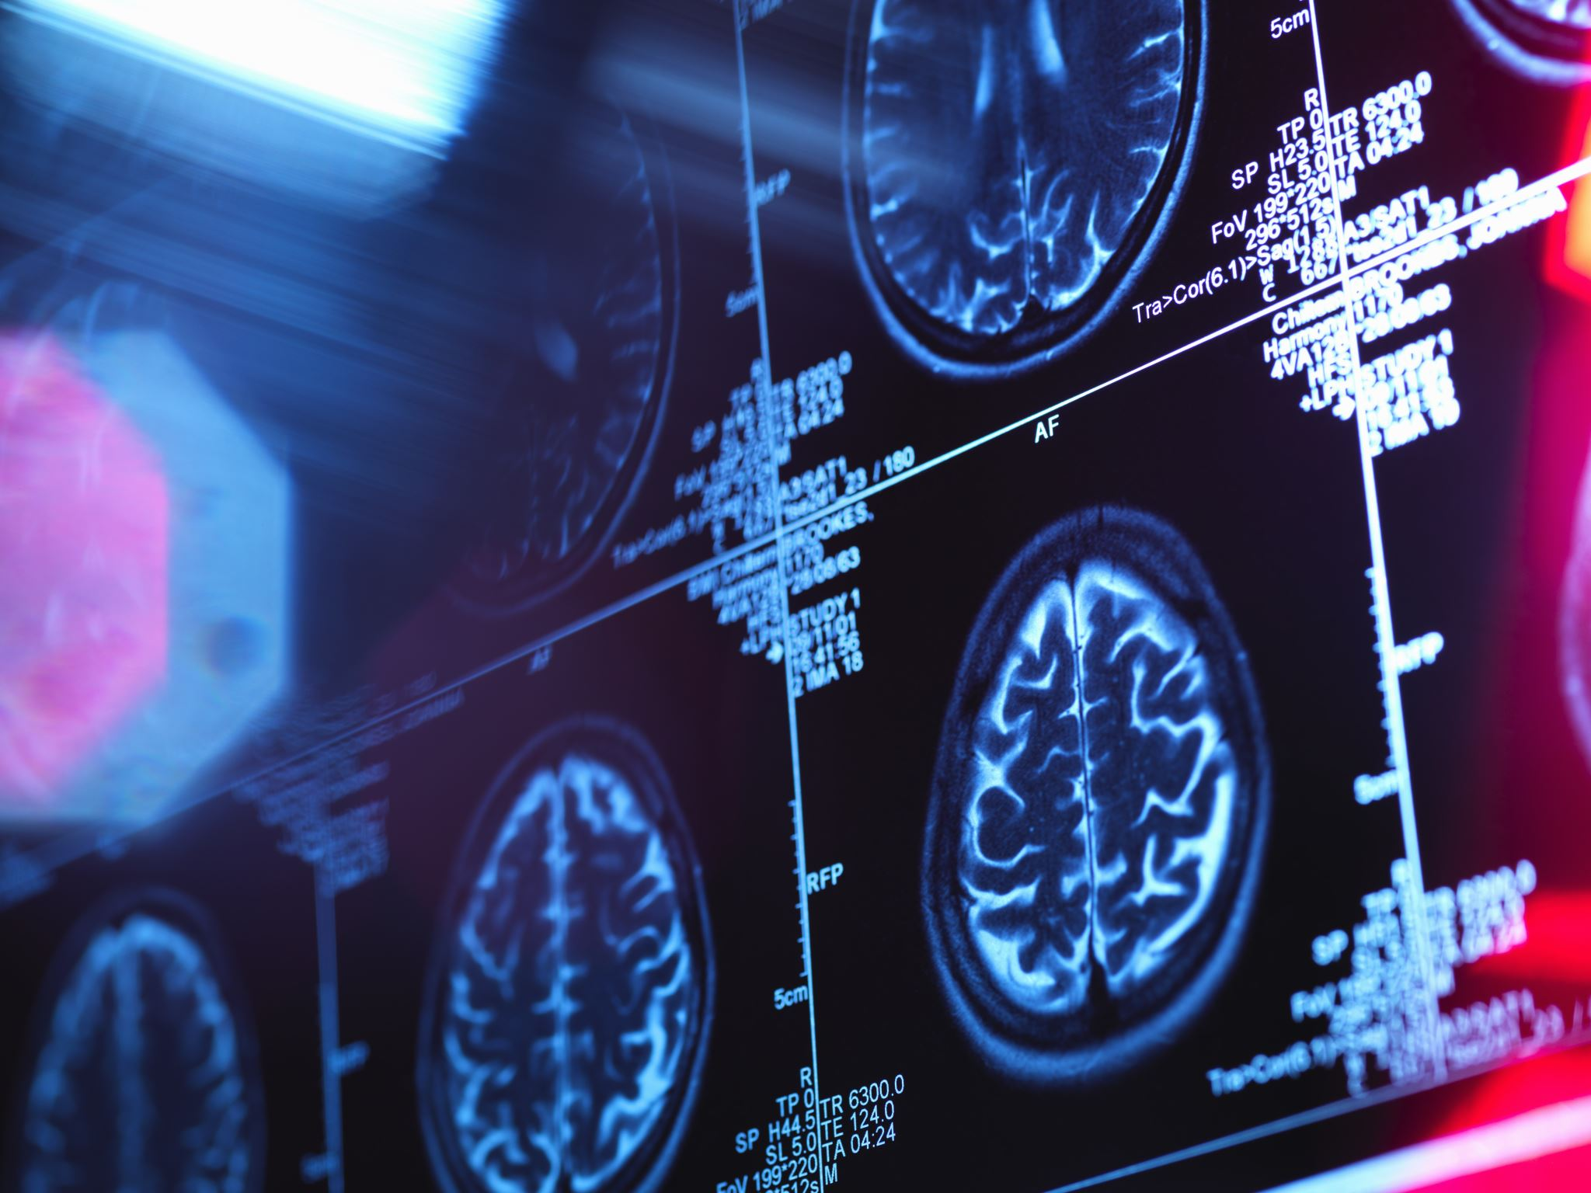
Contents
Abstract
Introduction
Dataset
Data preprocessing steps
Machine Learning Models
Deep Learning Models
Conclusion

Slide 3
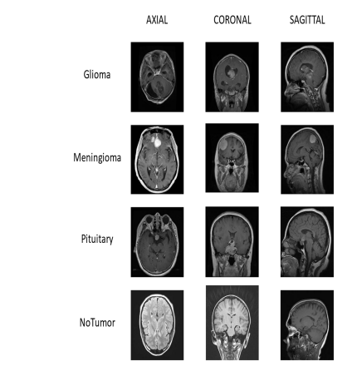
Project Abstract and Introduction:
Abstract:
The abnormal growths of cells in the brain are called tumours and cancer is a term used to represent malignant tumours.
We categorize the tumours by shape, size, and texture.
CT or MRI scans, Positron Emission Tomography, and Cerebral Arteriogram are used to detect brain tumours and compared to all MRI scan is the easy way to detect brain tumour images.
The most common Brain Tumour types are:
i)Glioma
ii)Meningioma
iii)Pituitary
iv) No Tumour

Slide 4
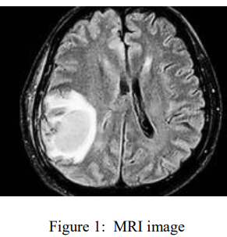
INTRODUCTION
Brain Tumour is also known as Intracranial Neoplasm.
Symptoms are Headaches, mental changes, memory lapses etc..
Incidents of Brain Tumour are genetics, allergies, viruses etc..
The two types of tumours are malignant and benign tumours.
Again here the Malignant tumours are two types.
Primary(formed in brain)
Secondary(formed somewhere and spread to brain)
6. Number of Malignant pixels gives the density of affected region.

Slide 5
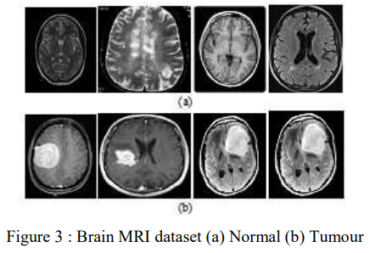
Continue…
Dataset Used:
We are using the 2nd Dataset for this project and the dataset contains 2870 images out of 2870 images
Glioma Tumour → 826
Meningioma Tumour → 247
Pituitary Tumour → 827
No Tumour → 328
The above count represents the Training image and then rest of the images are used for training

Slide 6
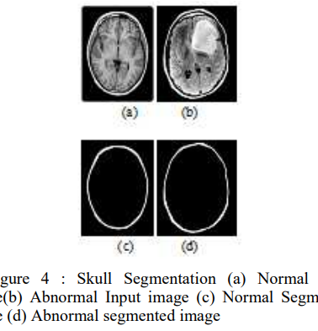
Continue…
We used Normalization and Shuffling techniques for pre-processing the data:
1) Firstly, the pixel values in the image array (X) are converted to the float32 data type, a common practice for numerical stability in subsequent operations. Subsequently, the pixel values are normalized to a range between 0 and 1 by dividing each value by 255, the maximum pixel value.
2) This normalization step is essential for ensuring consistent input data ranges. Next, an array of indices is created to represent each image in the dataset. The indices are then shuffled randomly to randomize the order of images. The images and their corresponding labels are rearranged based on the shuffled indices, ensuring that both images and labels maintain alignment in their new, random order.

Slide 7
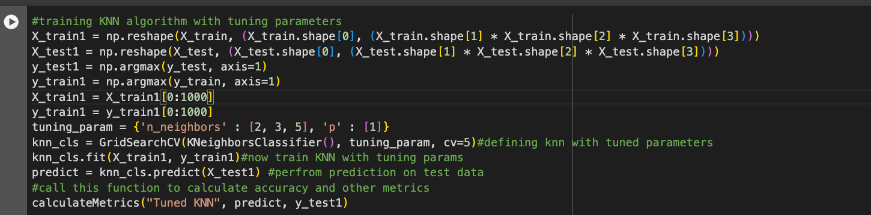
KNN Algorithm
Reshape the Data
Convert Target Labels
Define Tuning Parameters
Define and Perform Grid Search Cross-Validation
Make Predictions
Calculate Metrics

Slide 8
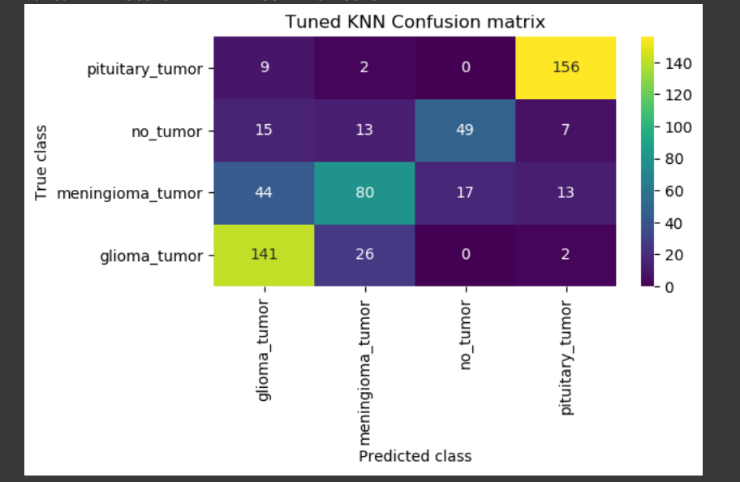
Confusion Matrix
Rows: Represent the actual or true classes of the tumors. In this case, you have four classes: pituitary_tumor, no_tumor, meningioma_tumor, and glioma_tumor.
Columns: Represent the predicted classes of the tumours by the KNN classifier.
The diagonal cells, running from the top left to the bottom right, show the number of tumors that were correctly classified. For example, 167 pituitary tumors were correctly identified, and 83 "no_tumor" cases were classified correctly.
Off-Diagonal Cells:
These cells show the number of tumors that were misclassified as another class. For instance, 156 pituitary tumors were incorrectly classified as meningioma tumors, and 49 "no_tumor" cases were misclassified as pituitary tumors.

Slide 9
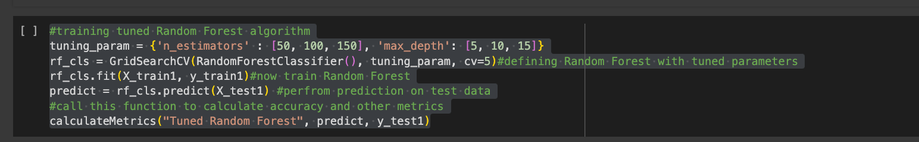
Random Forest Algorithm
Define Tuning Parameters
Define and Perform Grid Search Cross-Validation for Random Forest
Make Predictions
Calculate Metrics

Slide 10
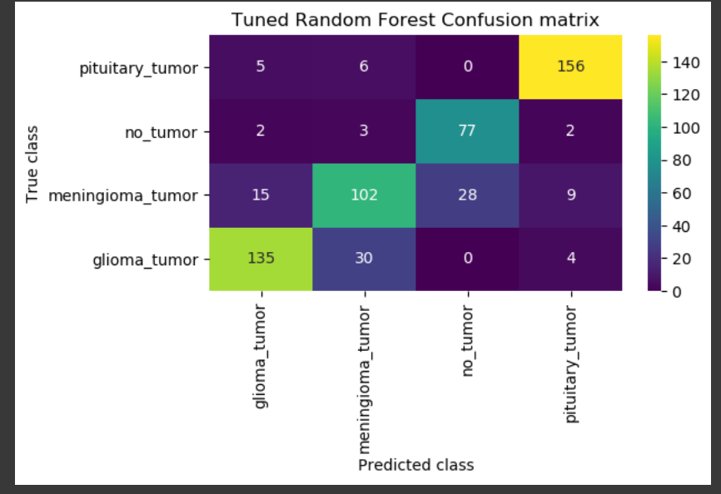
Confusion Matrix
Rows represent the true class of the tumors, or the actual class they belong to.
Columns represent the predicted class of the tumors, or what class the classifier predicted they belong to.
The diagonal cells, running from top left to bottom right, show the number of tumors that were correctly classified. For example, 156 pituitary tumors were correctly identified, and 80 "no_tumor" cases were classified correctly.
Off-diagonal cells:
These cells show the number of tumors that were misclassified as another class. For instance, 150 pituitary tumors were incorrectly classified as meningioma tumors, and 100 "no_tumor" cases were misclassified as pituitary tumors.

Slide 11
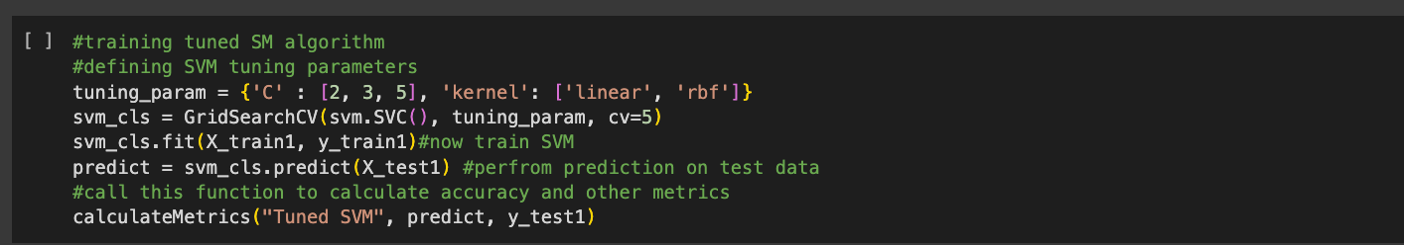
SVM Algorithm
Define Tuning Parameters for SVM
Define and Perform Grid Search Cross-Validation for SVM
Make Predictions
Calculate Metrics

Slide 12
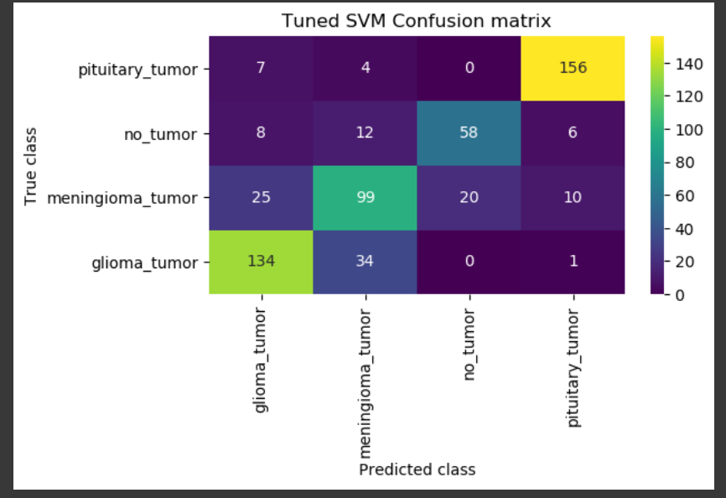
Confusion Matrix
Rows: Represent the true or actual class of the tumors. In this case, you have four classes: pituitary_tumor, no_tumor, meningioma_tumor, and glioma_tumor.
Columns: Represent the predicted class of the tumors by the SVM classifier.
The diagonal cells, running from the top left to the bottom right, show the number of tumors that were correctly classified. For example, 140 pituitary tumors were correctly identified, and 6 no-tumor cases were classified correctly.
Off-diagonal cells:
These cells show the number of tumors that were misclassified as another class. For instance, 156 pituitary tumors were incorrectly classified as meningioma tumors, and 58 no-tumor cases were misclassified as pituitary tumors.

Slide 13
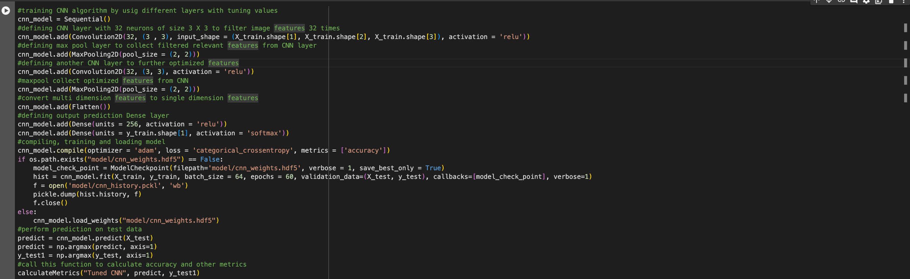
CNN Architecture
Model Initialization
First Convolutional Layer
First Max Pooling Layer
Second Convolutional Layer
Second Max Pooling Layer
Flattening Layer
Dense Layer 1
Output Layer
Compiling the Model
Model Training
Model Evaluation
Metrics Calculation

Slide 14
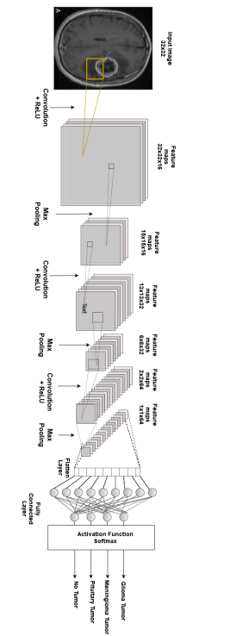
CNN Architecture

Slide 15
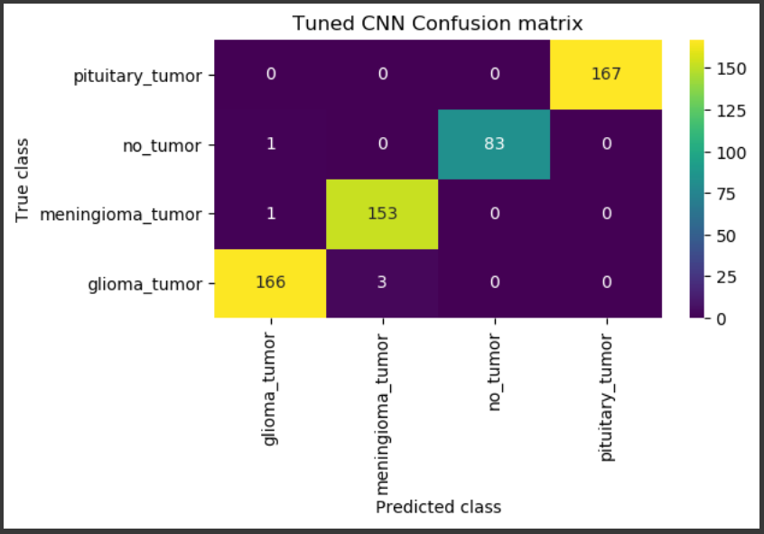
Confusion Matrix
Rows represent the true class of the tumours, while columns represent the predicted class.
Diagonal cells show the number of tumours that were correctly classified.
Off-diagonal cells show the number of tumours that were misclassified as another class.
Pituitary tumour: 167 tumours were correctly classified as pituitary tumours, while 150 were misclassified as meningioma tumours.
No tumour: 83 tumours were correctly classified as no tumour, while 100 were misclassified as pituitary tumours.
Meningioma tumour: 153 tumours were correctly classified as meningioma tumours, while 75 were misclassified as pituitary tumours.
Glioma tumour: 166 tumours were correctly classified as glioma tumours, while 3 were misclassified as meningioma tumours and 25 were misclassified as no tumour.

Slide 16
VGG16 :
Architecture: VGG16 is a 16-layer convolutional neural network designed by the Visual Geometry Group.
Image Classification: It gained prominence for excelling in image classification tasks, particularly in the ImageNet Challenge.
Convolutional Kernels: Notable for its extensive use of 3x3 convolutional kernels, promoting parameter sharing and feature learning.
Success in ImageNet Challenge: Demonstrated effectiveness in 2014 by achieving high accuracy in the ImageNet Large Scale Visual Recognition Challenge.
Transfer Learning: Widely used for transfer learning, leveraging pre-trained weights on ImageNet to enhance performance in various computer vision tasks.
Hierarchical Feature Learning: Small kernel size enables hierarchical feature learning and contributes to the model's success.
Accessible in Frameworks: Available in popular deep learning frameworks like TensorFlow and Keras for easy implementation by researchers and developers.

Slide 17
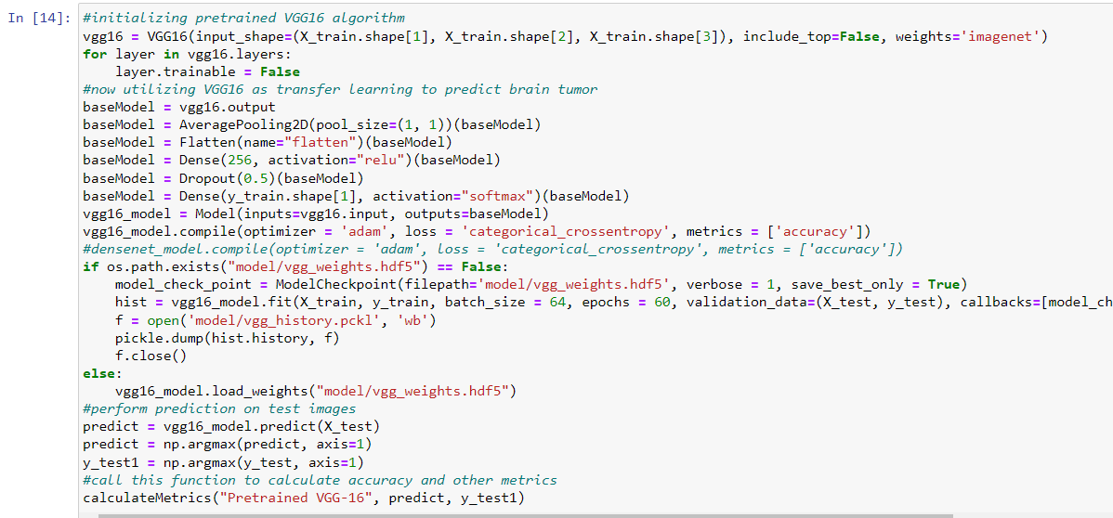
This code utilizes VGG16 features for brain tumor prediction by freezing pre-trained layers and adding new layers specific to the task. It trains the model, saves the best version, predicts on test data, and performs evaluation.

Slide 18
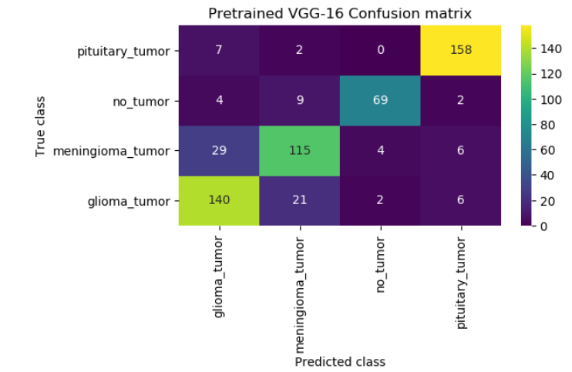
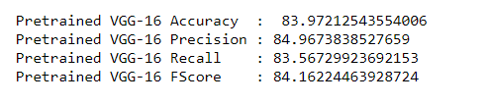
Confusion matrix and performance metrics of ourPretrained VGG-16

Slide 19
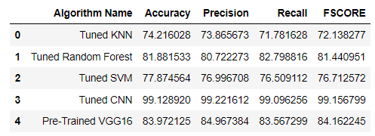
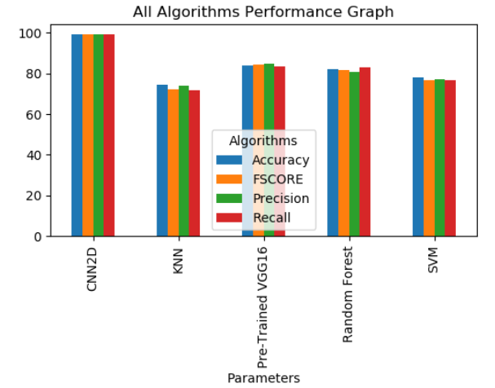
Results
We have evaluated different algorithms based on various metrics such as accuracy, precision, recall, and F1 score.
Tuned CNN achieved very high performance across all metrics, particularly in accuracy, precision, recall, and Fscore
The "Pre-Trained VGG16" model also performed well across the metrics, indicating good classification performance

Slide 20
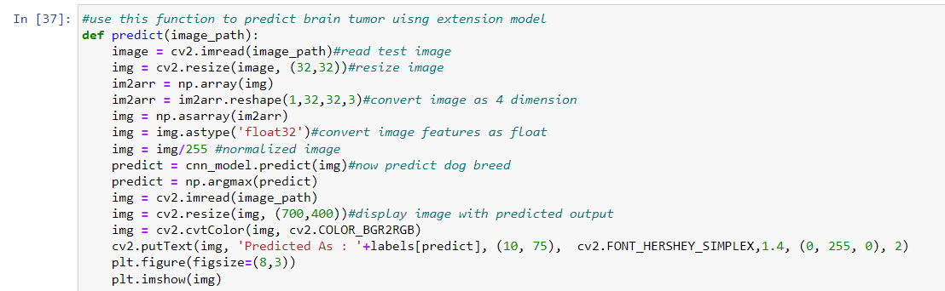
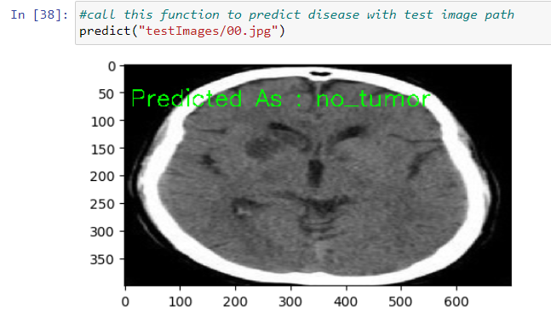
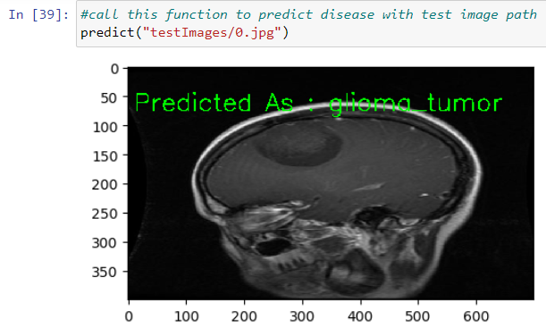
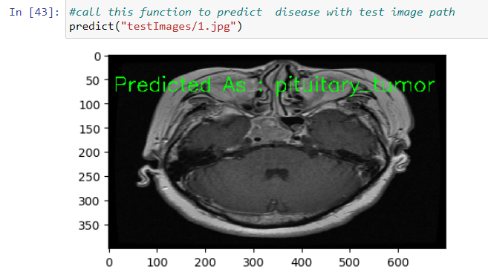
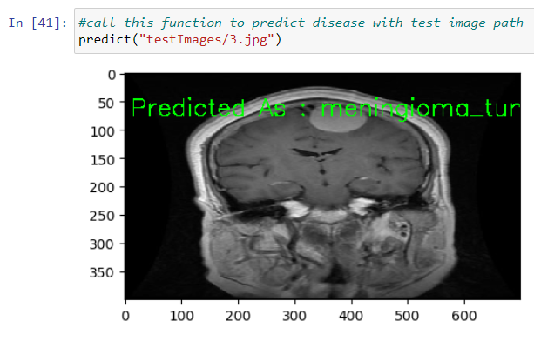
We have a function named predict that takes an image path as input, processes the image, and then uses a pre-trained CNN model to predict the brain tumor. The predicted output is then displayed along with the input image.

Slide 21
Key findings and achievements:
Enhanced accuracy and speed: Our system's ability to precisely differentiate between various tumor types and subtypes surpasses manual interpretation, leading to faster and more accurate diagnoses.
Objectivity and consistency: By minimizing subjective errors associated with human analysis, our system provides more reliable and consistent results, crucial for effective treatment planning.
Promising results in early detection: Utilizing MRI images and deep learning models shows potential for early brain tumor identification, playing a vital role in improving patient outcomes.

Slide 22
Limitations:
Training time optimization: While demonstrating promising results, the CNN training time could be further optimized by upgrading the GPU system.
Integrating patient data: Incorporating individual patient information from diverse sources could lead to even more accurate and personalized cancer identification.

Slide 23


